Slide 1



Machine Learning Techniques for Heart Disease Detection
Utilizing Random Forests, Decision Trees, and Hybrid Model
Project Group no : CSERGC0341
Course Code : CSE445
Mentor Name : Jatinder Kaur (Assistant Professor)
Name Registration No.
Nikhil Yadav 12015390
Sharique Ahmad 12105943
Maibam Suraj Singh 12002241
Shiv Shankar Singh 12018635

Slide 2

Contents
Introduction
Objectives
Dataset
Methodology
Machine Learning Models
Accuracy Results
Snapshot
Conclusion
Publication
References

Slide 3
Introduction
Heart disease affects millions of people globally and can be fatal.
Early detection and accurate diagnosis are crucial for effective treatment.
Machine learning (ML) techniques can help in diagnosing heart disease.
This study explores different ML algorithms to detect heart disease:
K-Nearest Neighbors (KNN)
Random Forests
Decision Trees
Hybrid model (combining above these methods)
Goal: Identify the most accurate method for heart disease detection.
Aim: Improve diagnosis, support early intervention, and enhance patient outcomes.

Slide 4
Objectives
Investigate Machine Learning Algorithms:
Explore the effectiveness of various machine learning algorithms in detecting heart disease.
Focus on classifiers such as Support Vector Machines (SVM), Random Forests, Decision Trees, and a hybrid model.
Evaluate Classifier Performance:
Conduct extensive experimentation to assess the performance of each classifier.
Compare accuracy, robustness, and generalizability of the models.
Identify Optimal Method:
Determine the best machine learning approach for heart disease detection.
Analyze results to highlight the most reliable and accurate model for clinical use.
Enhance Diagnostic Accuracy:
Aim to improve early detection and diagnosis of heart disease.
Provide healthcare professionals with effective tools for better patient outcomes.

Slide 5
Dataset
Source:
The heart disease detection dataset is sourced from the Cleveland database, part of the UCI Machine Learning Repository.
This repository is renowned for its comprehensive collection of machine learning datasets.
Attributes:
The dataset comprises 76 characteristics, each potentially providing valuable insights into cardiovascular health.
Most published analyses focus on a specific subset of 14 characteristics.
Age: Age of the patient.
Sex: Gender of the patient.
Chest Pain Type (cp): Type of chest pain experienced, categorized into four types.
Resting Blood Pressure (trestbps): Resting blood pressure (in mm Hg).
Serum Cholesterol (chol): Serum cholesterol level (in mg/dl).
Fasting Blood Sugar (fbs): Fasting blood sugar level (greater than 120 mg/dl is considered abnormal).
Resting ECG Results (restecg): Resting electrocardiographic results.
Maximum Heart Rate Achieved (thalach): Maximum heart rate achieved.
Exercise-Induced Angina (exang): Presence of exercise-induced angina.
Oldpeak (ST Depression): ST depression induced by exercise relative to rest.
Slope of the Peak Exercise ST Segment (slope): Slope of the peak exercise ST segment.
Number of Major Vessels (ca): Number of major vessels colored by fluoroscopy.
Thalassemia (thal): It a blood disorder, with values indicating normal, fixed defect, or reversible defect.

Slide 6

Methodology
Data Loading and Exploration:
Utilize the versatile capabilities of the pandas library in Python to load the heart disease dataset.
The dataset, stored in a CSV file named "heart.csv," contains various clinical variables and parameters related to heart health.
Perform initial data exploration using functions such as shape, head(), and describe() to understand the dataset's structure and distribution.
Data Preprocessing:
Handle missing values and outliers to ensure data quality.
Normalize or standardize the data to improve model performance.
Split the data into training and testing sets to evaluate the model's generalizability.
Model Training and Evaluation:
Random Forests: Train a Random Forest classifier, tune hyperparameters for optimal performance, and evaluate its accuracy.
Decision Trees: Train a Decision Tree classifier and assess its accuracy.
K-Nearest Neighbors (KNN): Scale the features for better performance, train the KNN classifier with varying numbers of neighbors, and select the best model.
Hybrid Model: Combine the predictions of Decision Trees, Random Forests, and KNN to create a hybrid model. Calculate the average prediction and evaluate its performance.
Performance Metrics:
Use accuracy as the primary metric to compare the performance of different classifiers.
Identify the model with the highest accuracy through extensive experimentation and analysis.
Model Saving:
Save the trained models for future use using Python's pickle library.
Example: Save the Gaussian Naive Bayes model as "heart_nav_bay.sav" for later deployment or further experimentation.

Slide 7

Machine Learning Models
Random Forests
Description: Random Forest is an ensemble learning method that constructs multiple decision trees during training.
Application: Suitable for both classification and regression tasks, known for handling high-dimensional data.
Role in Heart Disease Detection: Evaluating Random Forest's accuracy and robustness in predicting heart disease.
Decision Trees
Description: Decision Trees are tree-like structures that classify instances based on feature attributes.
Application: Easy to interpret and visualize, useful for understanding data patterns.
Role in Heart Disease Detection: Analyzing Decision Trees' ability to identify critical features for heart disease diagnosis.
Facilities 2
Hybrid Model
Description: Hybrid Model combines multiple machine learning algorithms to leverage their strengths.
Application: Integrating Random Forests, and Decision Trees to improve predictive accuracy.
Role in Heart Disease Detection: Investigating the synergistic effects of combining classifiers for enhanced heart disease detection.

Slide 8
Accuracy Results
Decision Tree
Random Forest
K-Nearest Neighbors (KNN)
Hybrid Model
Accuracy: 81%
The decision tree classifier achieved an accuracy of 81% in predicting heart disease cases.
Accuracy: 90%
The random forest classifier exhibited a significantly higher accuracy of 90% compared to the decision tree model.
Accuracy: 97%
Our hybrid model, which combines multiple classifiers, demonstrated the highest accuracy of 97% among all models tested.
Accuracy: 88%
The KNN algorithm yielded an accuracy of 88% in identifying heart disease cases.
These accuracy scores reflect the effectiveness of different machine learning techniques in detecting heart disease. The hybrid model, leveraging the strengths of various classifiers, emerged as the most accurate and promising approach for heart disease detection in our study.

Slide 9
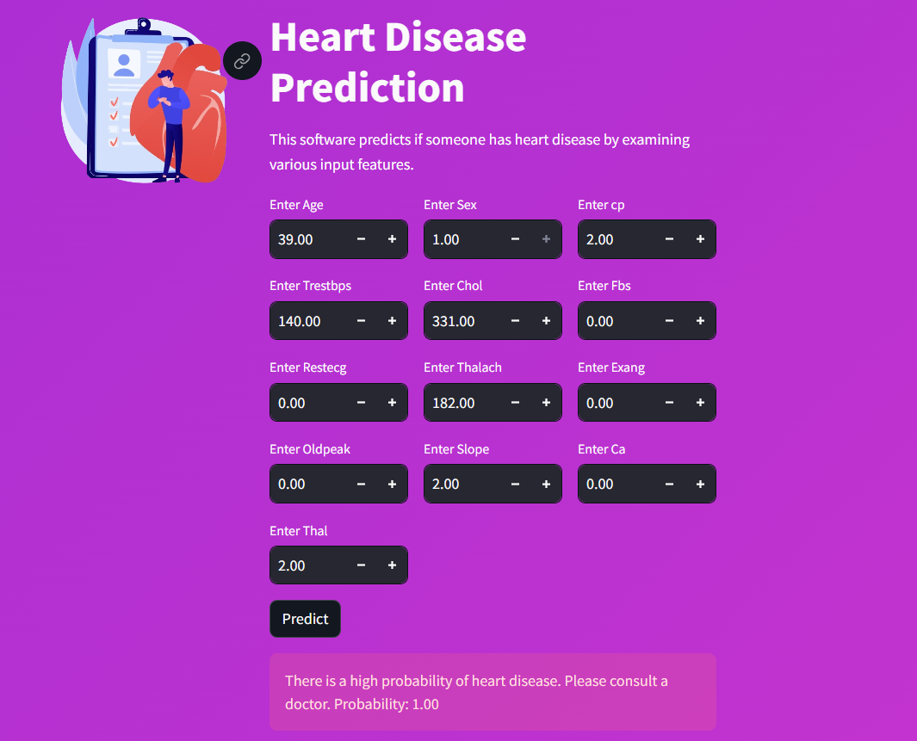

Snapshot

Slide 10

Conclusion
Explored efficacy of ML algorithms for heart disease detection
Compared KNN, Random Forests, Decision Trees, and Hybrid Model
Hybrid Model showed highest accuracy
ML crucial for early detection and precise diagnosis in healthcare
Potential for improved patient outcomes with timely interventions
Future research focus: model interpretability, data governance, transparent AI solutions
ML revolutionizing cardiovascular healthcare
Vision: early identification, effective treatment, and prevention of heart diseases for a healthier society

Slide 11
Future Scope
Data Integration: Develop robust techniques for handling heterogeneous data sources effectively.
Model Interpretability: Enhance ML model interpretability for easier clinical adoption.
Transparency and Explainability: Incorporate methods for transparent model explanations and feature importance analysis.
Advancing Cardiovascular Healthcare: Utilize ML for early diagnosis and personalized intervention in heart diseases.
Improving Patient Outcomes: Aim for improved patient outcomes and quality of life through ML-driven solutions.

Slide 12
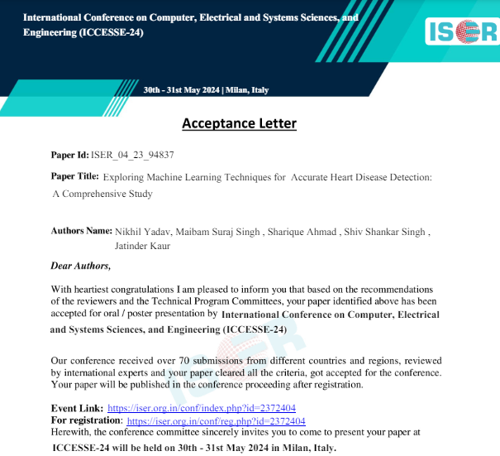
Publication

Slide 13
References
[1] K. Ledebur, A. Kautzky-Willer, S. Thurner, and P. Klimek, "Optimal prevention strategies for chronic diseases in an compartmental disease trajectory model," 2024.
[2] L. García-Terriza, J. L. Risco-Martín, G. Reig Roselló, and J. L. Ayala, "Predictive and diagnosis models of stroke from hemodynamic signal monitoring," 2023.
[3] U. Niemann, A. Neog, B. Behrendt, K. Lawonn et al., "Cardiac Cohort Classification based on Morphologic and Hemodynamic Parameters extracted from 4D PC-MRI Data," 2020.
[4] A. Maach, J. Elalami, N. Elalami, and E. Houssine El Mazoudi, "An Intelligent Decision Support Ensemble Voting Model for Coronary Artery Disease Prediction in Smart Healthcare Monitoring Environments," 2022.
[5] A. S. Eisman, N. R. Shah, C. Eickhoff, G. Zerveas et al., "Extracting Angina Symptoms from Clinical Notes Using Pre-Trained Transformer Architectures," 2020.
[6] R. Selvaraj, T. Satheesh, V. Suresh, and V. Yathavaraj, "Optimized Machine Learning for CHD Detection using 3D CNN-based Segmentation, Transfer Learning and Adagrad Optimization," 2023.
[7] S. M Mehedi Zaman, W. Mahmood Qureshi, M. Mohsin Sarker Raihan, O. Monjur et al., "Survival Prediction of Heart Failure Patients using Stacked Ensemble Machine Learning Algorithm," 2021.
[8] B. Roudini, B. Khajehpiri, H. Abrishami Moghaddam, and M. Forouzanfar, "Machine learning predicts long-term mortality after acute myocardial infarction using systolic time intervals and routinely collected clinical data," 2024.

Slide 14
[9] M. Saifuzzaman and T. Nuri Ananna, "Towards Smart Healthcare: Challenges and Opportunities in IoT and ML," 2023.
[10] H. Hejbari Zargar, S. Hejbari Zargar, and R. Mehri, "Review of deep learning in healthcare," 2023.
[11] K. Kwakye and E. Dadzie, "Machine LearningBased Classification Algorithms for the Prediction of Coronary Heart Diseases," 2021.
[12] S. Bandyopadhyay, J. Wolfson, D. M. Vock, G. Vazquez-Benitez et al., "Data mining for censored timeto-event data: A Bayesian network model for predicting cardiovascular risk from electronic health record data," 2014.
[13] F. Shishehbori and Z. Awan, "Enhancing Cardiovascular Disease Risk Prediction with Machine Learning Models," 2024.
[14] N. Alamatsaz, L. s Tabatabaei, M. Yazdchi, H. Payan et al., "A lightweight hybrid CNN-LSTM model for ECG-based arrhythmia detection," 2022.
[15] J. Clarke and D. Seo, "An ensemble approach to improved prediction from multitype data," 2008.
[16] X. Wang and H. Zhu, "Artificial Intelligence in Image-based Cardiovascular Disease Analysis: A Comprehensive Survey and Future Outlook," 2024.
[17] A. Khan, A. Sohail, U. Zahoora, and A. Saeed Qureshi, "A Survey of the Recent Architectures of Deep Convolutional Neural Networks," 2019.

Slide 15
Thank You

